Slide 1
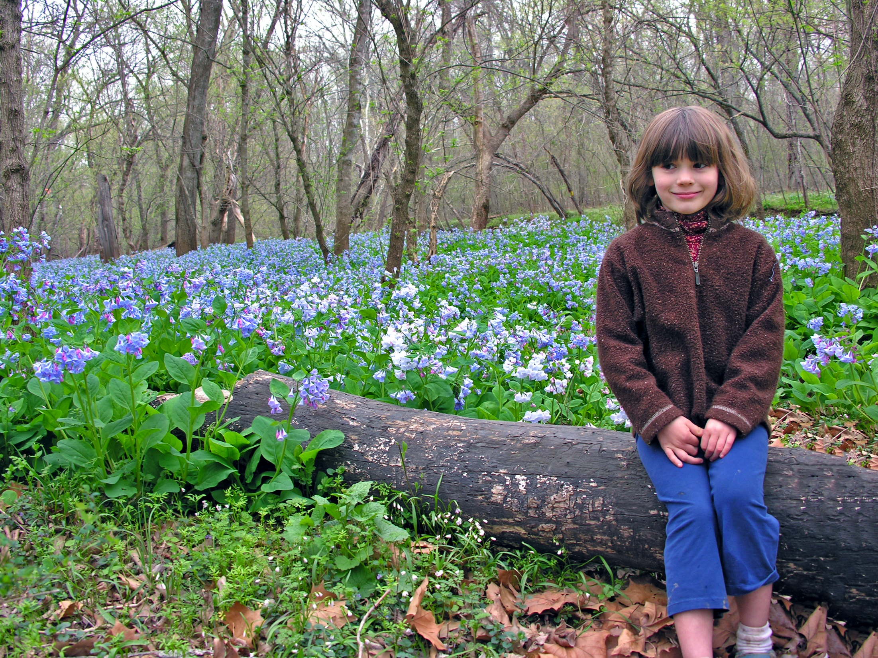
We are lucky to live and work in an area that is rich in cultural and natural resources. We are the only locality in the DMV region that spans from tidal wetlands to a mountain, and protects a Rural Crescent. Together these create a unique landscape that is the foundation of the County’s appeal.

Slide 2
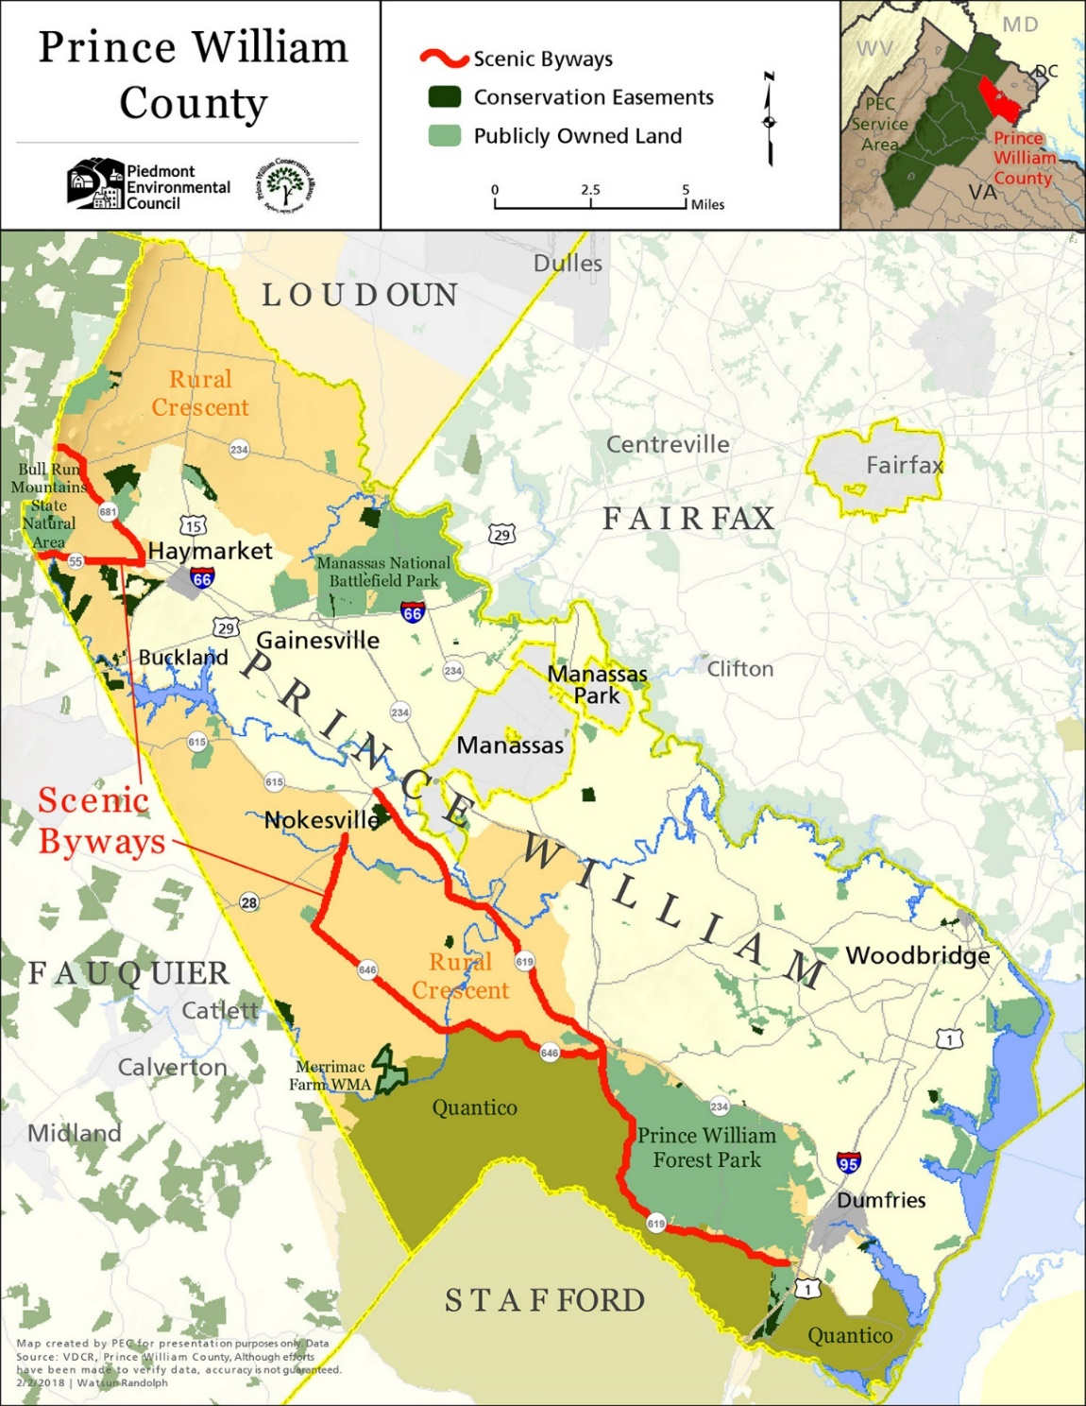
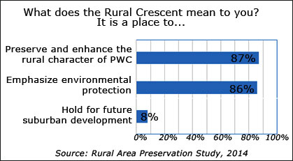
The Rural Crescent
Notes:
The Rural Crescent was adopted by a 5-3 in 1998 with strong community support from throughout the county. The five votes to approve came from Supervisors in the development area.
Although one occasionally hears that residents in east PW are not supportive of the Rural Crescent, there is plenty of evidence showing otherwise. County surveys consistently show strong support for maintaining the Rural Crescent. Elections in the Occoquan District, notably 1999 and 2019, the Rural Crescent played a leading role, with the winning candidates expressing strong support. Anecdotally, community forums and grassroots advocacy also show strong support. And overall, there are considerably more people who live in east PW, the development area. The Rural Crescent would not have survived for more that 20 years without their support.

Slide 3
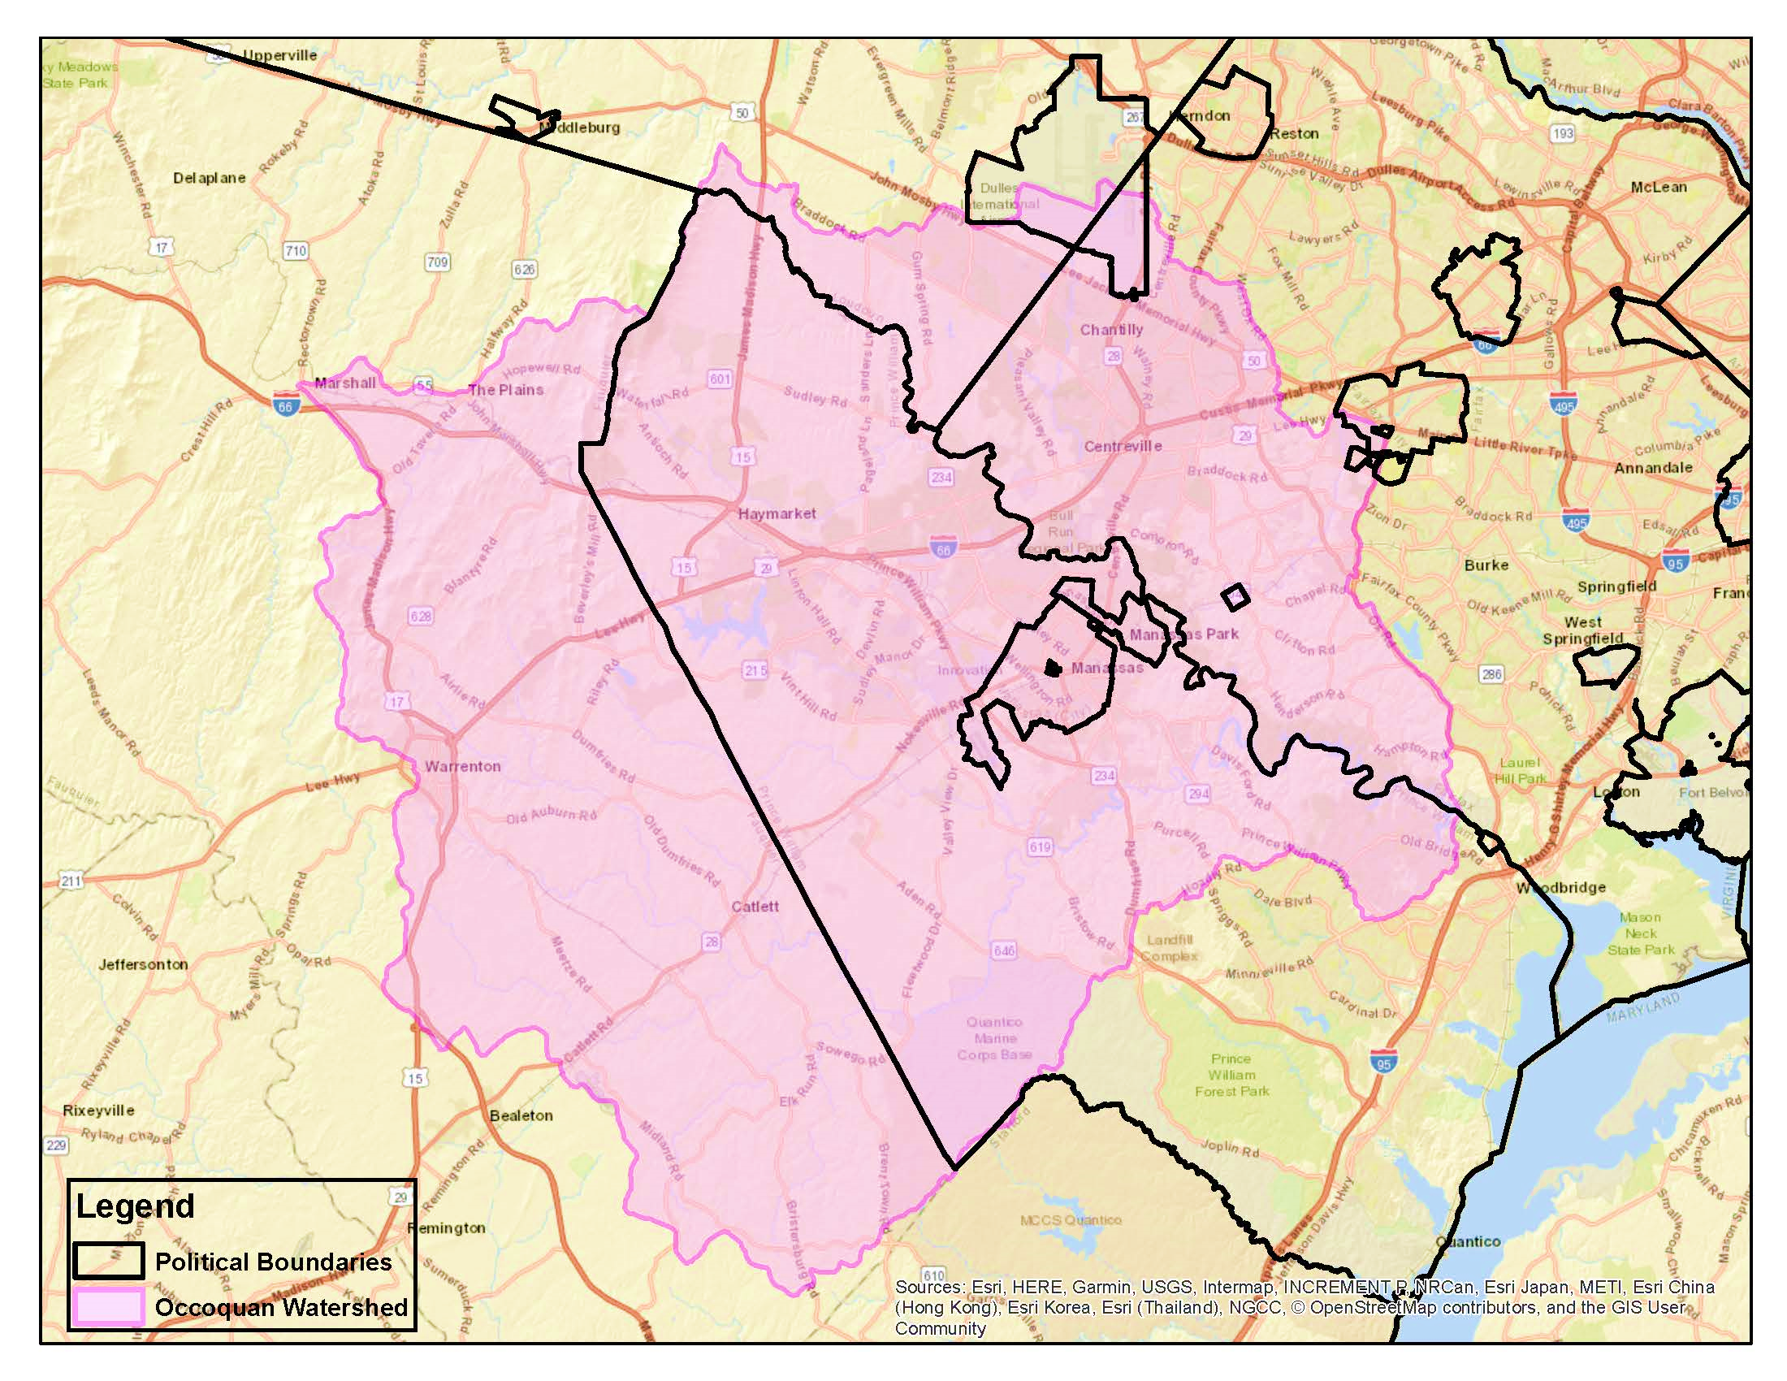
PWC staff comments warn that approval would allow a "dramatic change to the land use with associate far reaching impact to natural resources." They recommend that the Comprehensive Plan remain unchanged.

Slide 4
