Slide 1
Water and Rural Crescent
Elizabeth Ward
Green Risks

Slide 5
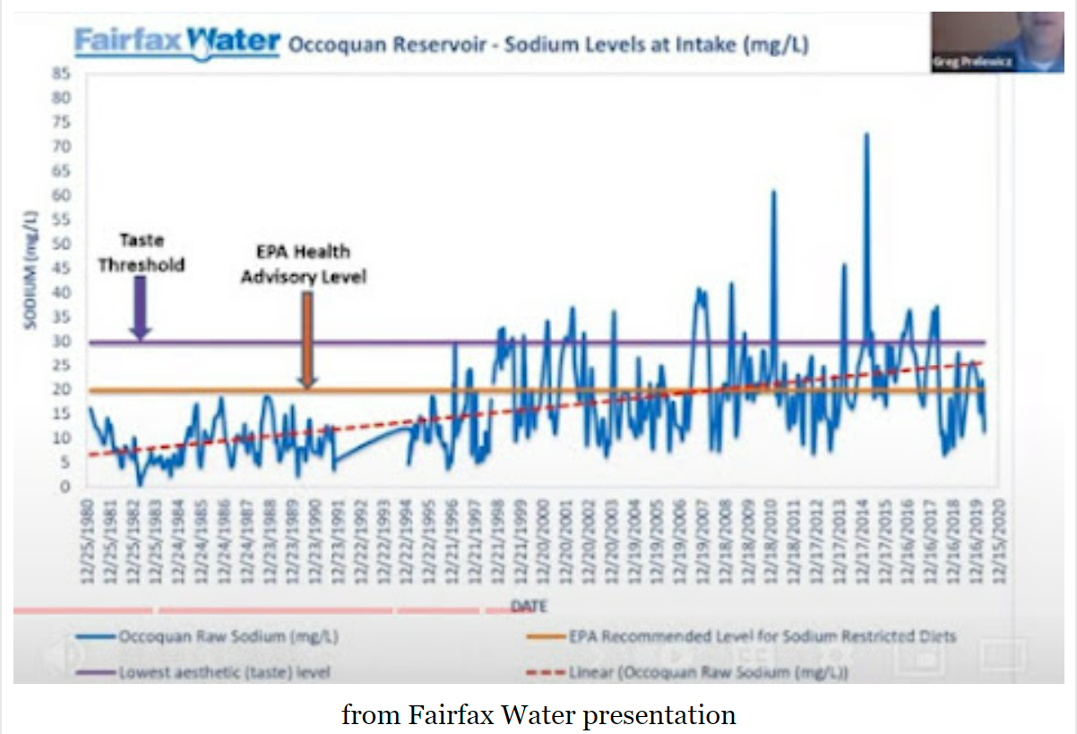

Slide 6
